Slide 1
Senior Capstone Casa Colina Employee Scheduler
Adam Garcia Fall 2020
In Collaboration with Casa Colina
Advisor: Dr. Renee Renner

Slide 2
Project overview & Motivation
Overview
The goal of this project is to create an employee scheduling platform that will streamline all tasks involving employee scheduling. Allow a company the able to update/post schedules, communicate with employees, accept timecard submissions remotely and automatically. All while increasing efficiency and eliminating human error.
Motivation
Two out of three of my last employers did not use database driven scheduling systems. Using basic methods always resulted in human error. Employees would be over scheduled, under scheduled, delays int getting schedules out. This not only affected the employers but the also the morale of employees.

Slide 3
Key Functionality
Permission based Restful API backend allowing applications secure access to the database.
Management given 24/7 access to edit/post schedules.
Messaging between management and employees.
Employee review and submission of timecards
Employee access to view schedules and update schedule availability

Slide 4
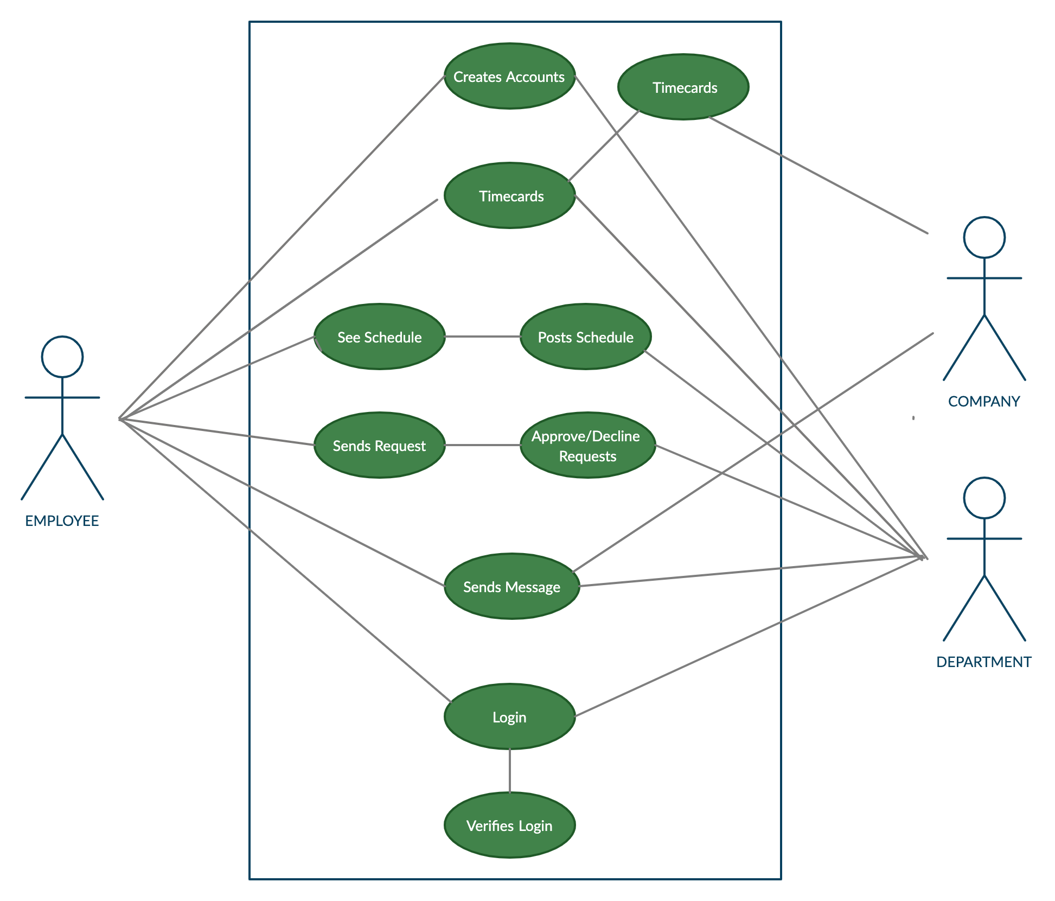
User Case Diagram
Employee
Company
Department

Slide 5
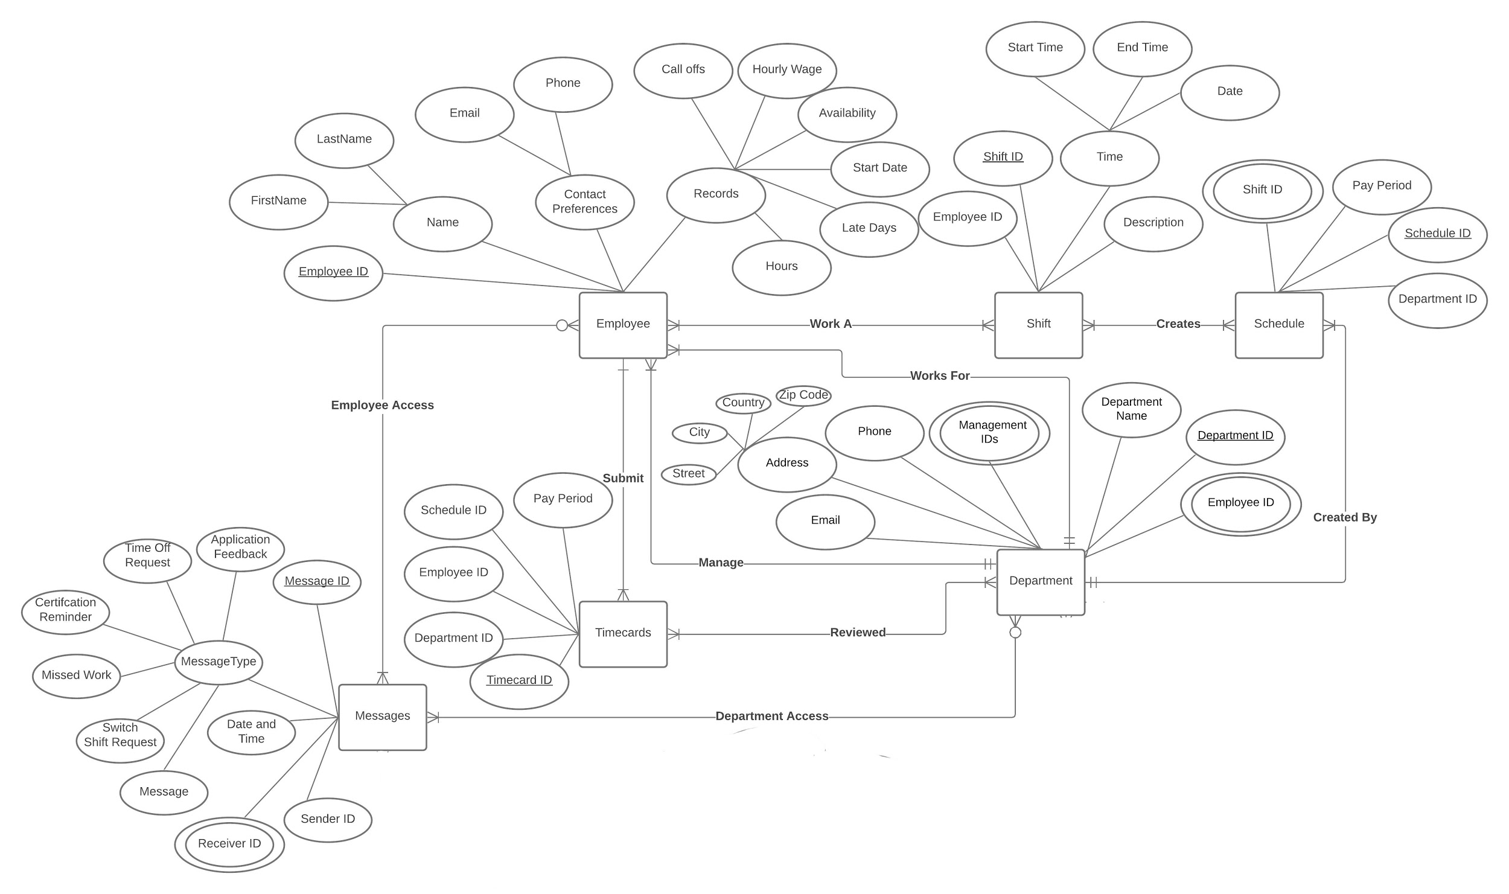
Entity Relationship Diagram
Entities:
Employees
Shift
Schedule
Department
Timecards
Messaging

Slide 6
Methodologies
This project is designed around the scheduling needs of Casa Colina (communication, error correction, useability) needs while also allowing for this platform to be scalable past the scope of this project.
The key feature that needs to be present in this project is the accessibility to all employees. Which made the design of a mobile application a mandatory element of design.
To provide multiple applications access to the database a REST API is required.

Slide 7
Tools / Programs
Main code bases:
Django ™
Django REST framework™
Python™
Flutter™
Server Hosting:
Apache HTTP Server™
Google Cloud™ VM Instance (http://35.233.225.216:8000)

Slide 8
Challenging Factors
Implementing a REST Api and using the requests library
Flutter learning curve

Slide 9
Outlook / Goals
- websockets with the REST API (to enable real time chat)
- Stronger token authentication
- IOS™ application development

Slide 10
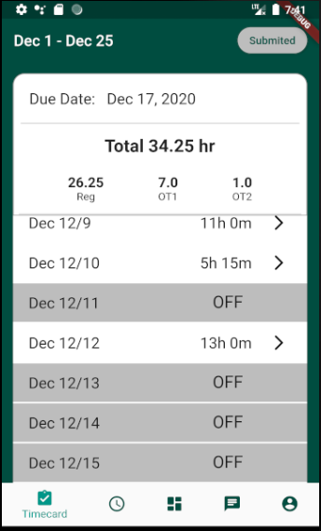
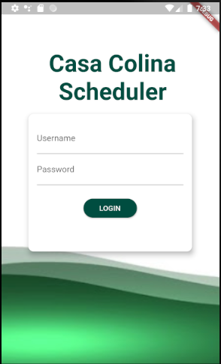
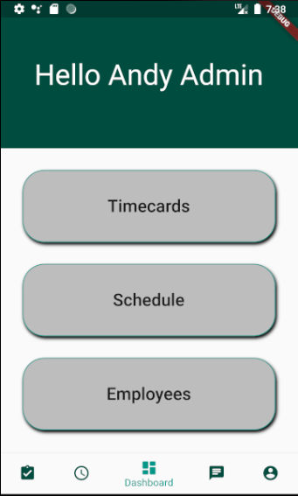
Final Results

Slide 11
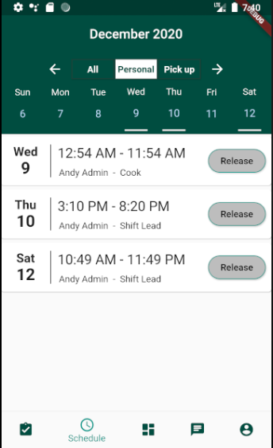
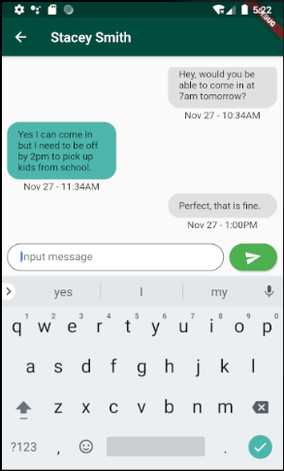
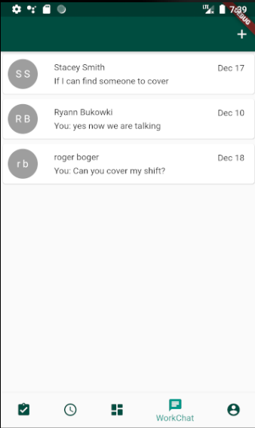
Final Results

Slide 12
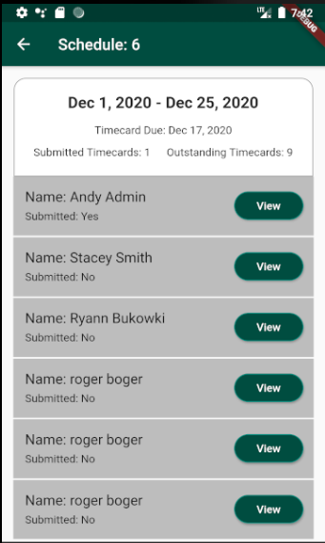
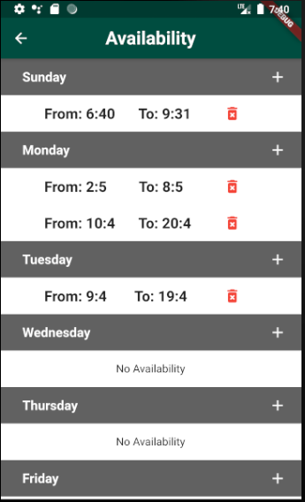
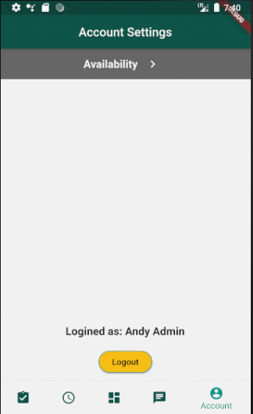
Final Results

Slide 13
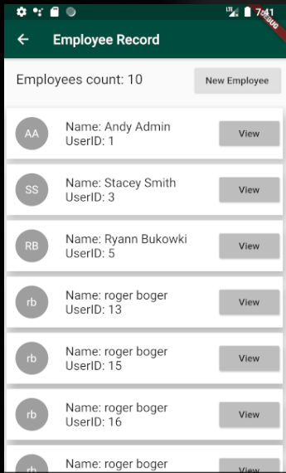
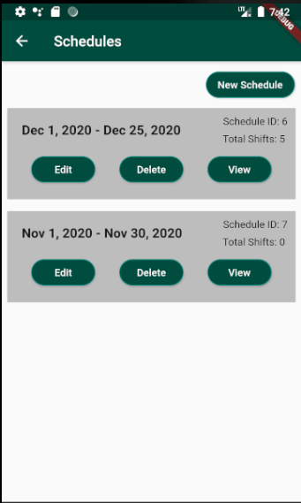
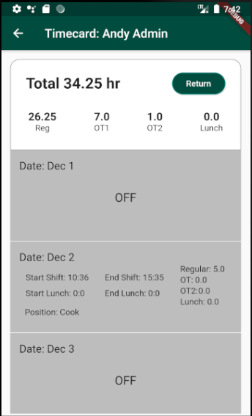
Final Results

